Slide 1
The Impact of Moneyball on Major League Baseball

Slide 2
Background
Moneyball by Michael Lewis: Nonfiction book about the Oakland Athletics in the early 2000s
Exploited inefficiencies in the player market to defy expectations with a low payroll
Key concepts: MLB Draft Rights, OBP vs BA
Project goal: Analyze changes at the team level and the role of money in MLB after Moneyball’s publication (2003)

Slide 3
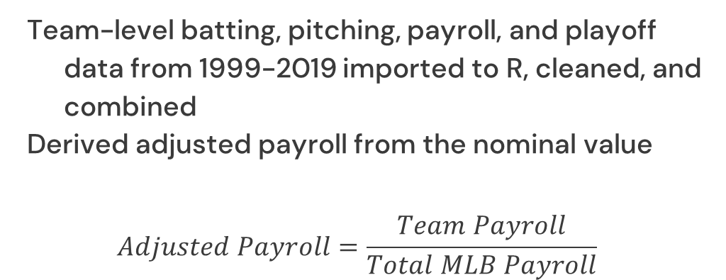
Data
Team-level batting, pitching, payroll, and playoff data from 1999-2019 imported to R, cleaned, and combined
Derived adjusted payroll from the nominal value
$$Adjusted Payroll=\frac{Team Payroll}{Total MLB Payroll}$$

Slide 4
Terms
Sabermetrics
The empirical analysis of baseball data
Plate Appearance
Number of times a player completes a turn batting, regardless of the result
OBP (On-Base Percentage)
Similar to batting average, but includes walks, HPB and SF

Slide 5
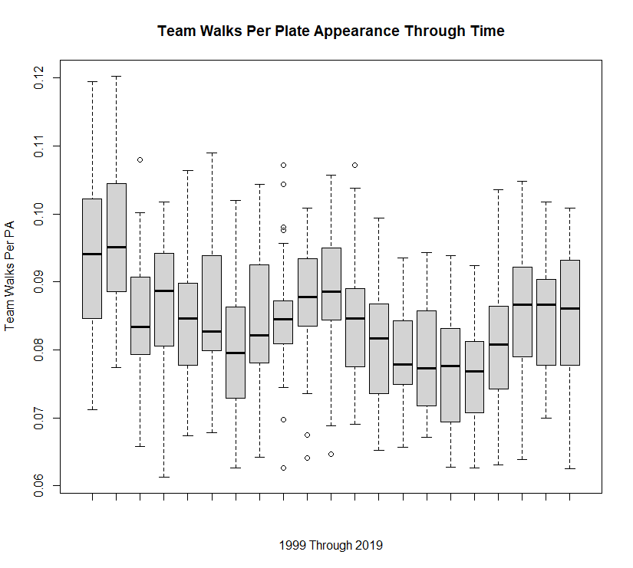
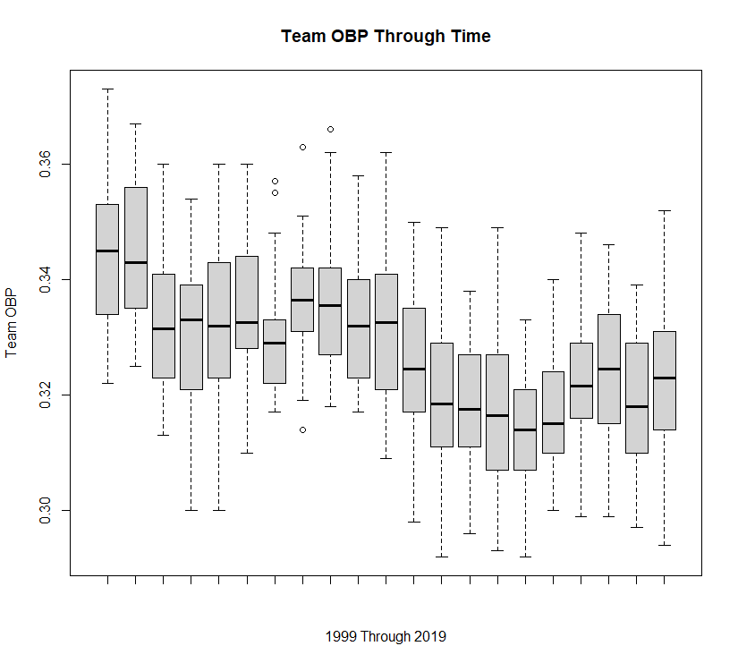
Walks and OBP Box Plots Through Time
Expected an upward trend in both charts since Moneyball revealed the importance of walks to a team’s success

Slide 6
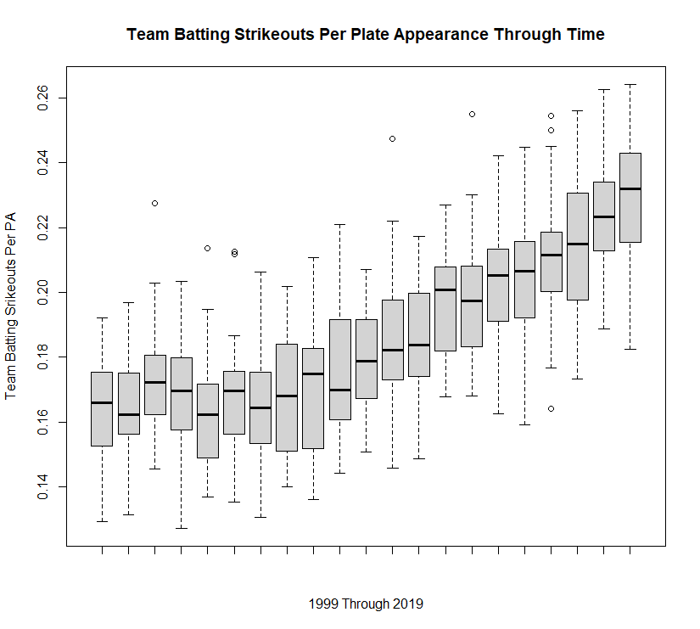
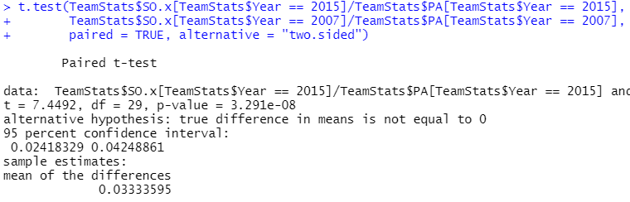
Strikeouts Through Time
Clear increasing trend in the proportion of strikeouts per plate appearance
Paired t-test shows a statistically significant increase in strikeout per plate appearance in 2015 compared to 2007

Slide 7
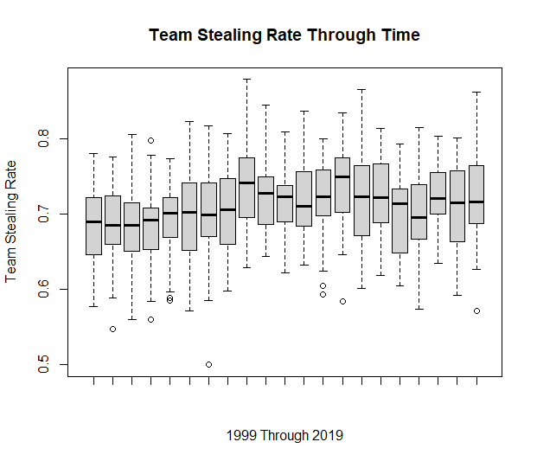
Base Stealing Rate Through Time
Important to preserve baserunners
Lower tail teams increased their stealing rate in the mid-2000s
Some early vs. recent seasons are statistically significant in paired t-tests

Slide 8
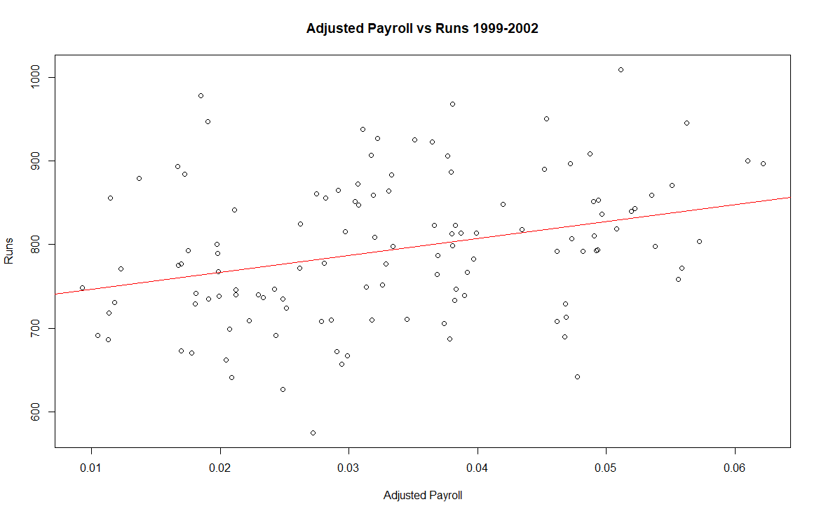
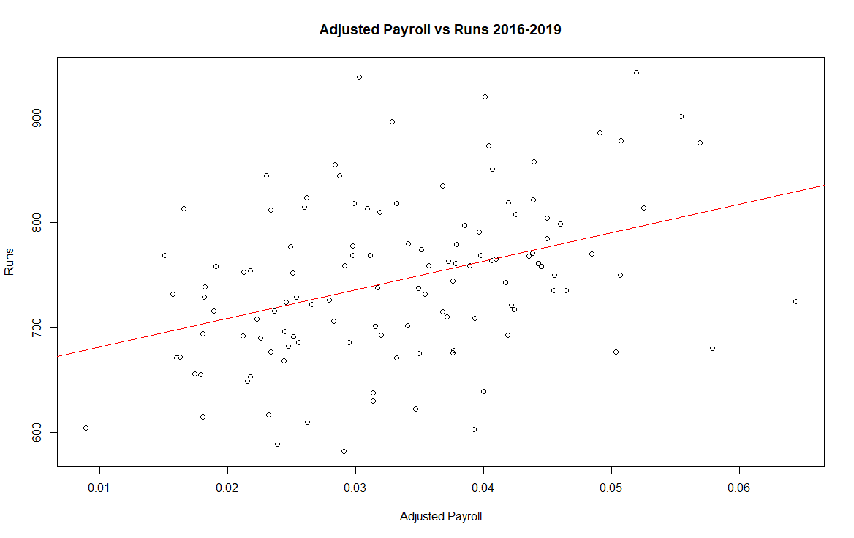
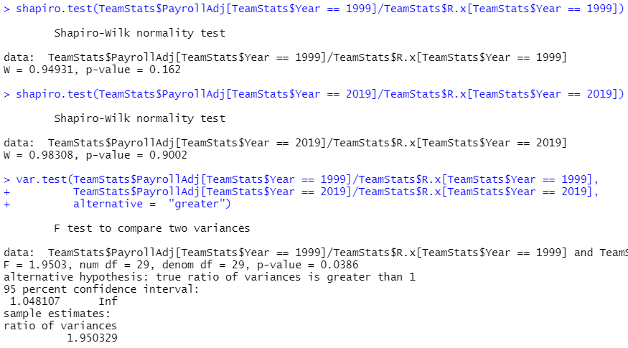
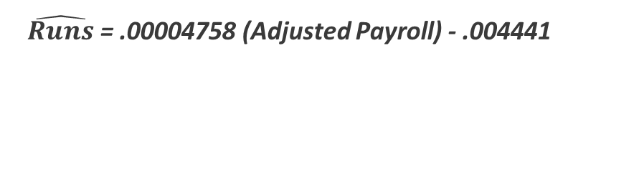
Adjusted Payroll Per Run
Weak correlations between adjusted payroll and runs in both cohorts
The 2016-2019 cohort has a slightly higher correlation (0.3850) than the 1999-2002 cohort (0.3104), but it’s not statistically significant
The variance of adjusted payroll per run significantly decreased from 1999 to 2019
$\hat{Runs}$ = .00004758 (Adjusted Payroll) - .004441
$\hat{Runs}$ = .00005445 (Adjusted Payroll) - .007246

Slide 9
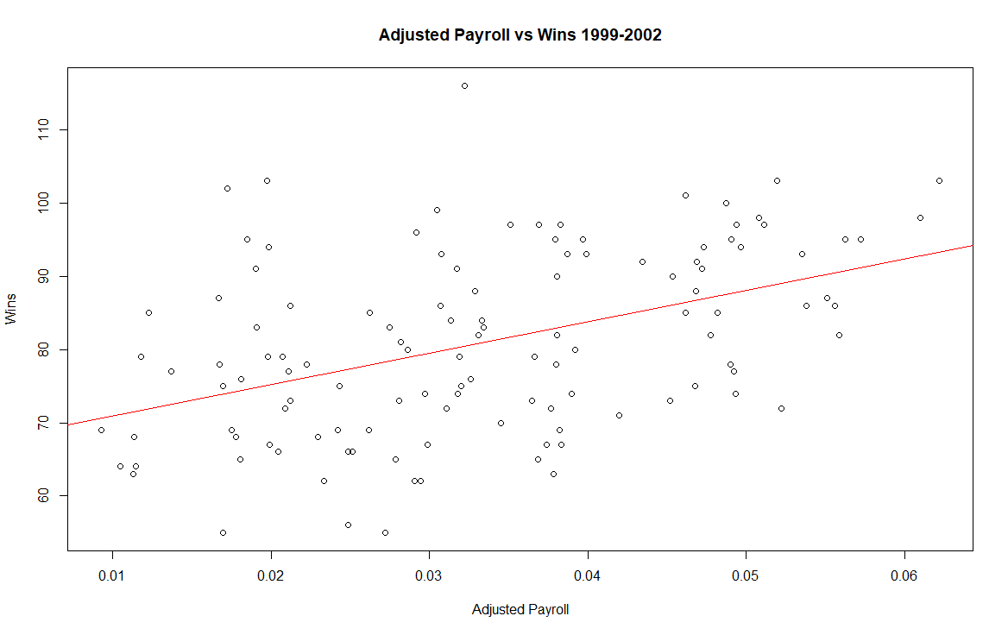
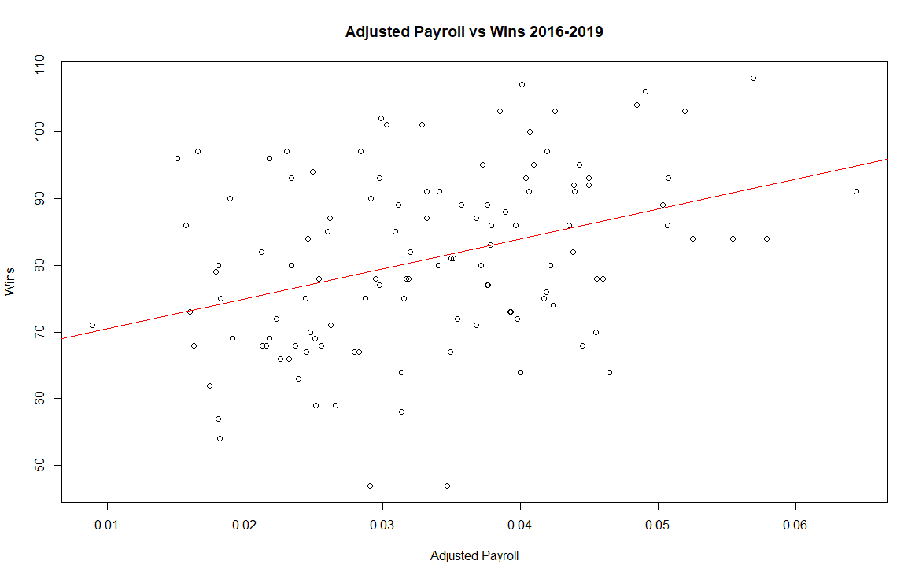
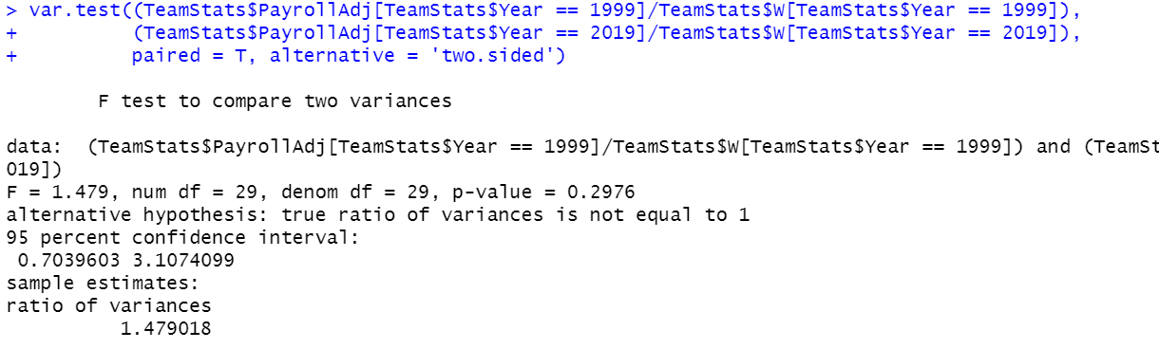
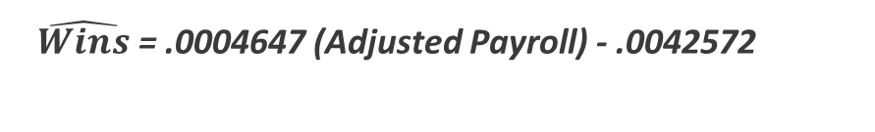

Adjusted Payroll Per Win
Weak correlation in the recent cohort and moderate correlation in the early cohort
The 2016-2019 cohort has a slightly lower correlation (0.3679) than the 1999-2002 cohort (0.4465), but it’s not statistically significant
Variance test on adjusted payroll per win is not significant
$\hat{Wins}$ = .0004647 (Adjusted Payroll) - .0042572
$\hat{Wins}$ = .0003017 (Adjusted Payroll) - .008906

Slide 10
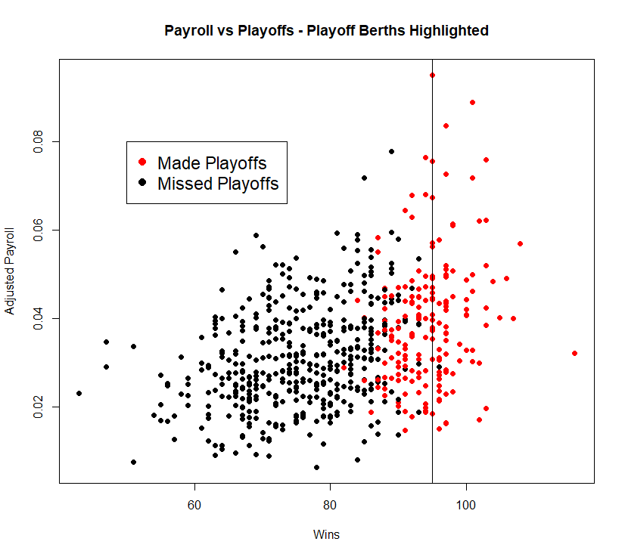
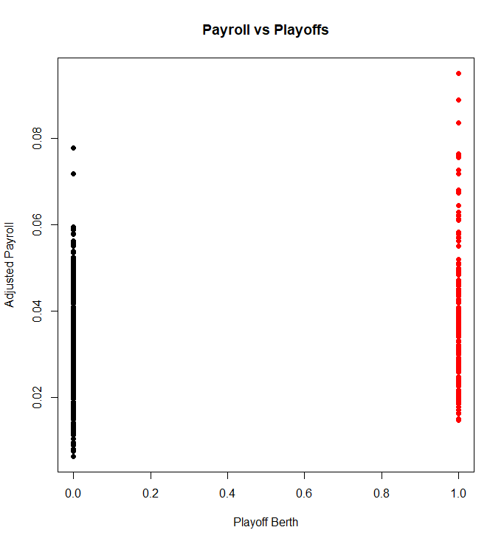
Playoff Berth by Wins and Payroll
Athletics estimated 95 wins to make the playoffs
There is a lot of overlap between adjusted payroll and achieving a playoff berth
Binary playoff berths show that very low payroll teams often miss the playoffs, while very high payroll teams frequently make the playoffs

Slide 11
Conclusion
Lack of increased walks and OBP post-Moneyball
Pitch optimization and difficulty in training plate discipline may be confounding factors
Teams are more careful about choosing to steal bases, in line with Moneyball practices
Linear regression of adjusted payroll vs runs and wins shows a possibly interesting but not statistically significant disconnect
Variance of adjusted payroll per run significantly decreased from 1999 to 2019, but not for adjusted payroll per win
Adjusted payroll has a strong effect on playoff berth when very high or very low

